Slide 1

W E L C O M E
today’s class
W E L COME

Slide 2
Identity
K.M.ABDUL BARI
AMOIN GPS
SHERPUR, BOGURA
Lesson
Sub: English
Class: five
Time: 40 min
Lesson: The hare and the tortoise
PH: 01716028465
bari64515@gmail.com

Slide 3
Learning outcomes
Student will able to:
Listening
1.3.1 recognize which words in a sentence are stressed.
4.2.1 understand and enjoy simple stories.
Speaking
1.1.1 say words,phrases and sentences with proper sounds and stress.
1.1.2 say sentences with proper intonation.
6.1.2 say what others are doing.
6.2.1 talk about people,objects, events etc.
Reading
1.5.1 read words,phrases and sentences in the text with proper pronunciation,stress and intonation.
1.7.1 read paragraphs ,dialogues stories ,letters and other texts.
5.1.2 read silently with understanding stories.
7.1.7 recognize punctuation marks and read accordingly

Slide 4
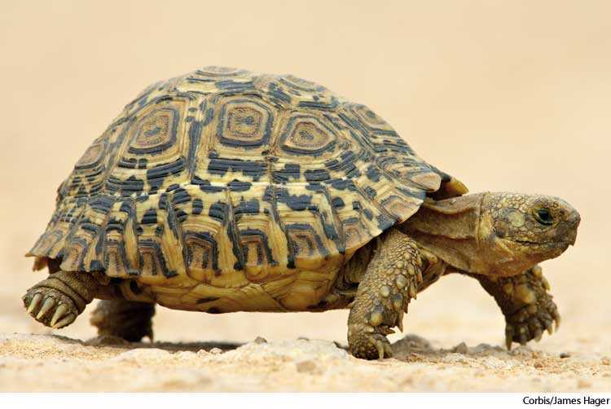
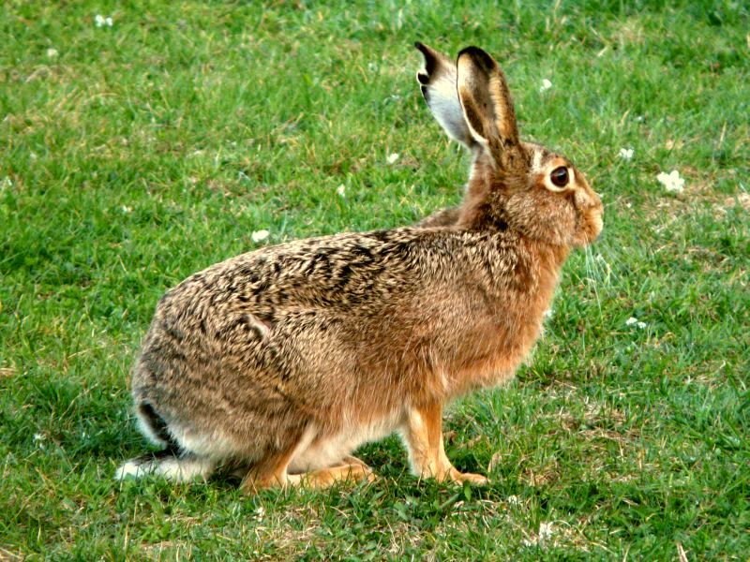
Warm up
Time: 1 min
Look at picture
Time: 1 min
Lesson declaration and write down on the board
Time: 1 min
The hare and the tortoise
(A(one day----began))

Slide 5
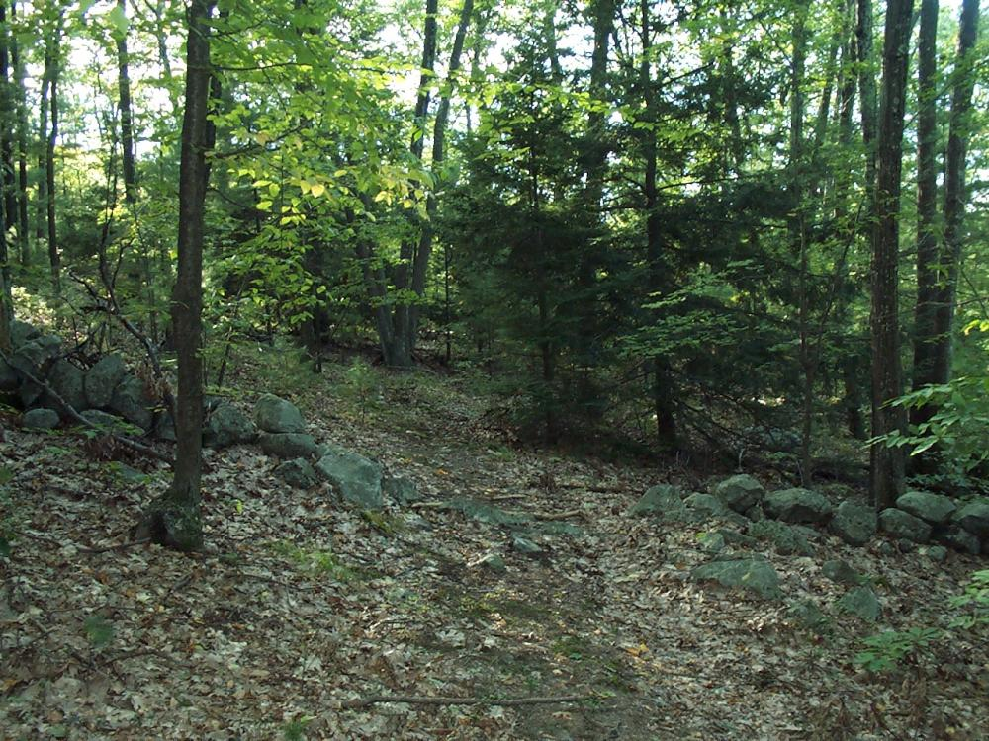
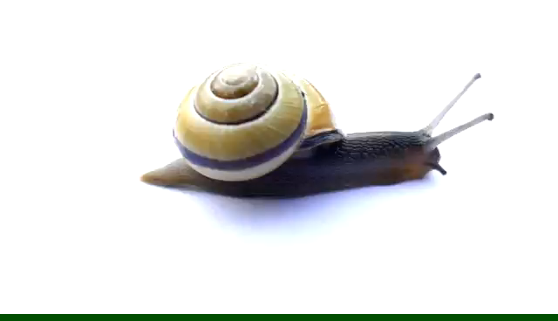
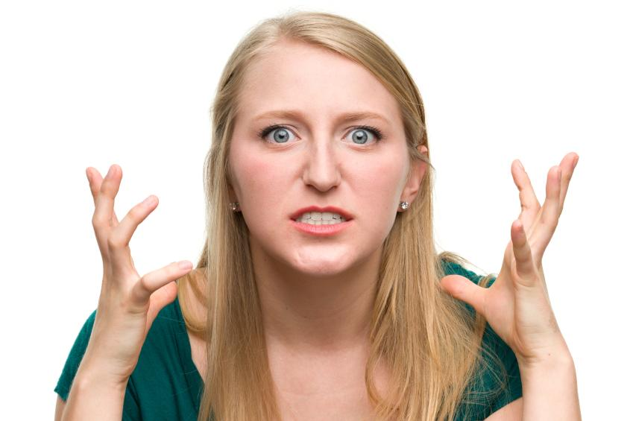
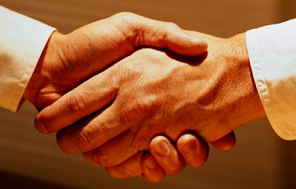
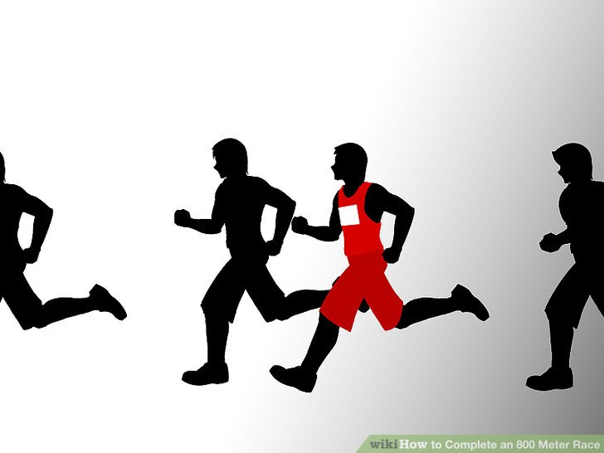
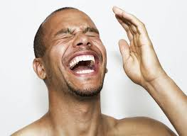
Indroducing new word(wcw)
Time: 4 min
Forest
Slow
Angry
Agreed
Laugh
Race

Slide 6
Teacher’s reading with st. loud reading(wcw)
Page 54
Time: 4 min
Explain in Bangla
One day, a har ---------the race began.
Page 54
Time: 4 min

Slide 7
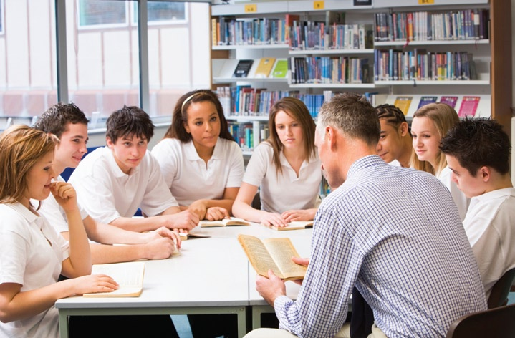
Student group reading(Sgw )
Time: 6 min

Slide 8
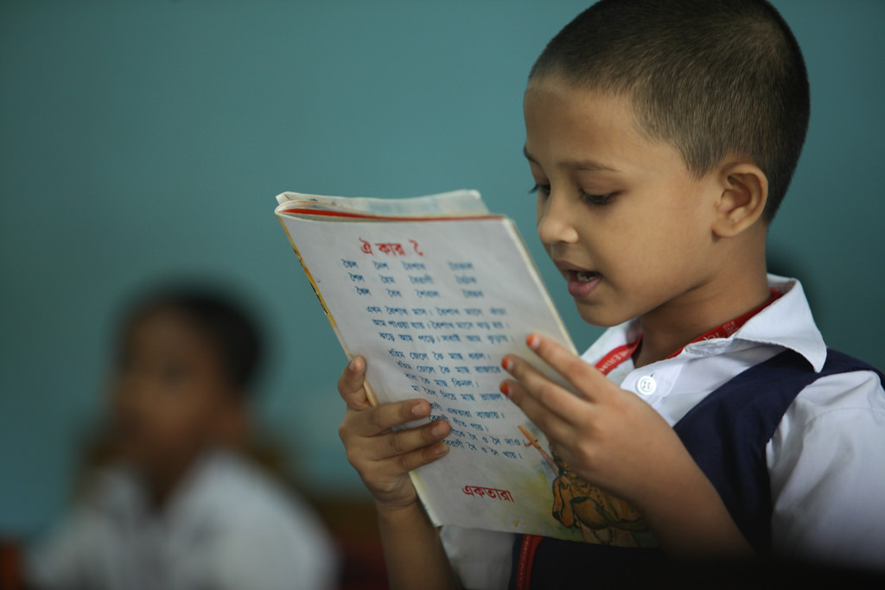
Student model reading (wcw )
Time: 4 min

Slide 9
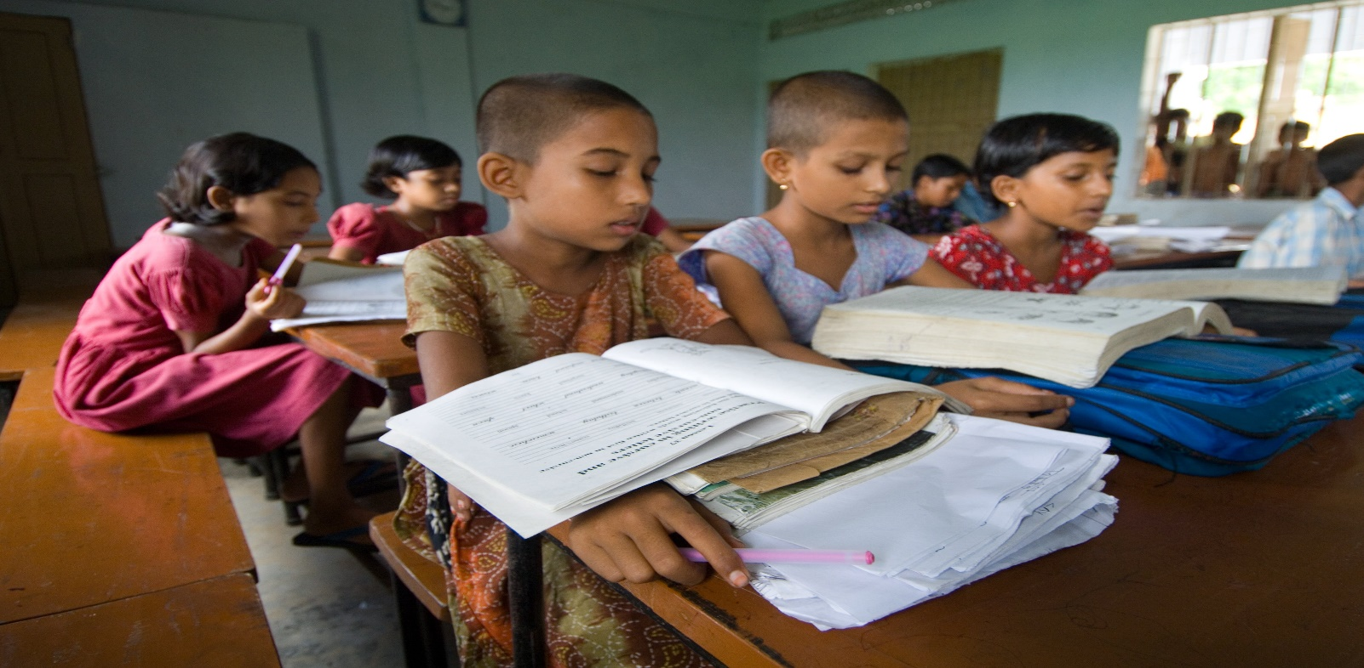
Student silent reading(IW)
At page 54(A)
Time: 4 min

Slide 10
Answer question drill(wcw)
Answer the following question:
Time: 5 min
1.Who was the fastest animal in the forsest?
2.Who was the slowest animal in the forsest?
3.Where did they start the race from ?
4.Why do you think the tortoise want to have
A race with the hare ?

Slide 11
Read the text:
Time: 5 min
They agreed to finish at the river
and Start from a big tree.Then they called their friend to watch the race. The race began.

Slide 12
Time: 30 sec
Slow but steady
Wins the race.

Slide 13

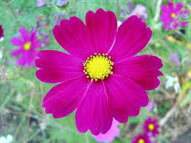
Thanks to all
Time: 30 sec

